Slide 1

OPTIMIZING STRING OPERATIONS USING
TRIE DATA STRUCTURE
TEAM MEMBERS:
M.MOUNIK SAI-(CB.SC.U4CSE23561)
J.ABHINAV SAI-(CB.SC.U4CSE23563)
K.NISHANTH-(CB.SC.U4CSE23523)
N.MITHILESH-(CB.SC.U4CSE23564)
K.SATWIQ -(CB.SC.U4CSE23521)
SAI VENKAT-(CB.SC.U4CSE23543)
TEAM NUMBER: F2

Slide 2
TITLE/PROBLEM STATEMENT:
Designing an Advanced Trie Data Structure for Efficient Data Storage, Retrieval, and DNA Pattern Matching in Text and Networking
CHALLENGES:
> Memory management
> Pattern Backtracking
> Handling Large Databases
> Provide Autocomplete Suggestions
> Enhancing DNA Sequence Matching
> Support URL/IP Address Matching & Longest Prefix
> Enable Pattern Matching
MOTIVATION BEHIND THE PROBLEM STATEMENT
Real-World Demand: The need for instant data access in applications like:
Search engines and dictionaries (text suggestions).
Network routing and firewall systems (IP routing).
Bioinformatics and content filtering (multi-pattern matching).

Slide 3
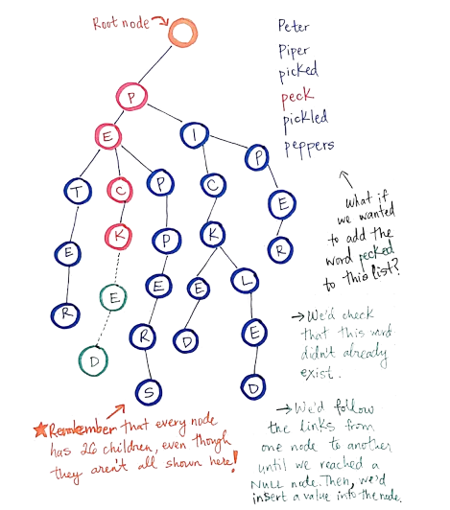

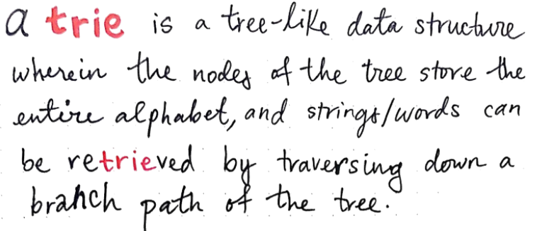
THE TRIE DATA STRUCTURE *A NEGLECTED GEM*:

Slide 4
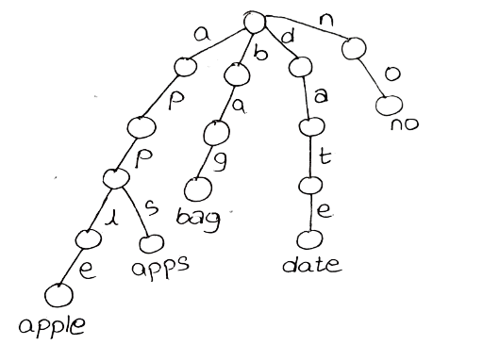
WHY USE A TRIE:
TrieInsertion: O(m) Prefix Search: O(m) Tries excel in applications requiring prefix search, shared prefix memory optimization,multi-pattern matching, and binary prefix matching.
COMPRASSION WITH OTHER DATA STRUCTURES:
Data Structure | Operations & Complexity | Why Not Used
Hash Table | Exact Search: O(1) Prefix Search: Not supported | Hash tables are efficient for exact matching but don’t support prefix or pattern matching as efficiently as Tries do.
Suffix Tree | Exact Search: O(m) Substring Match: O(m) | Suffix trees are effective for substring matching, but they are memory-intensive and complex to implement, making them less ideal for large dictionaries.
Binary Search Tree (BST) | Search: O(log⁡n)(balanced) Insert: O(log⁡n) (balanced) | BSTs are designed for ordered, non-prefix based operations. Prefix-based string matching is inefficient as traversal depends on alphabetic order rather than structure.

Slide 5
DESIGN CHOICE;DATA STRUCTURE FOR STORING CHILD NODES:
WITH AN ARRAY OF AN K ELEMENTS:
WITH A HASH TABLE
WITH A DYNAMIC ARRAY
WITH A LINKED LIST
Advantages:
Fast Access by Index
Simple Structure
Disadvantages:
Fixed Size
Inefficient Insertion and Deletion
Advantages:
Resizable
Indexed Access
Disadvantages:
Resizing Overhead
Slower Insertions/Deletions
Advantages:
Quick Lookup
Flexible Size
Disadvantages
Collisions.
No Order
Advantages:
Flexible Size
Efficient Insertions/Deletions
Disadvantages
Slow Access by Index
Higher Memory Usage
BEST CHOICE FOR OUR PROJECT:
AS LOOKUP TIME IS PRIMARY REQUIREMENT FOR OUR PROJECT, WE HAVE CHOOSED HASH TABLE AS IT OFFERS AVERAGE TIME COMPLEXITY FOR INSERTION,DELETION,AND LOOKUP IS O(1) DUE TO HASHING.

Slide 6
TRIE ADT:
Method | Time Complexity | Justification
add_word(word) | O(m) | Each character in the word results in either a node traversal or creation, making the operation linear in the length of the word.
search_word(word) | O(m) | Searches the Trie by character, taking linear time proportional to the word length.
Prefix_Matching(word) | O(m+k) | For applications requiring prefix-based lookups or matching on large datasets, Tries scale efficiently due to their dependence on the prefix length (m) and number of matches (k), rather than the total dataset size, offering a reliable and performant solution.
delete_word(word) | O(m) | Traverses each character in the word to mark and unmark the nodes for deletion, so the time complexity is linear in the length of the word. Recursion deletes nodes only if they’re unnecessary, ensuring efficiency without redundant traversals.

Slide 7
AUTO COMPLETE:
Autocomplete is a feature that suggests possible completions for a partially typed word or phrase. When a user begins typing, autocomplete generates a list of words or phrases that match the typed characters (or prefix), saving the user time by allowing them to select from a list of potential completions rather than typing the entire word or phrase.
Autocomplete is widely used in various applications to improve user experience and efficiency. Here are some common places where autocomplete is implemented:
DATA STRUCTURE USED:
Standard Trie
TIME COMPLEXITY & JUSTIFICATION:
O(p): The first part of the process involves finding the node corresponding to the last character of the given prefix. This requires a traversal of p nodes in the Trie (one for each character in the prefix), so this step is O(p).
O(k): Once the prefix node is found, the Trie performs a depth-first (or breadth-first) search starting from this node to retrieve all possible words that share the prefix. This part of the complexity is O(k), where k is the number of valid words found under the prefix node.
Overall Complexity: Combining these, the total complexity is O(p + k), where p is the time to locate the prefix node, and k is the time to retrieve and list all matching words.
> Search Engines,Messaging and Text Input,Coding and Development Environments,etc…

Slide 8
URL MATCHING:
URL matching is the process of checking whether a given URL matches a specific pattern or is part of a set of stored URLs. This is commonly used in web applications, security filtering, and routing to efficiently match incoming URLs against a list of known URLs or URL patterns.
Use Cases:
Web Application Routing,Security Filtering,Logging and Analytics
DATA STRUCTURE USED:
Standard Trie
TIME COMPLEXITY & JUSTIFICATION:
Finding the Node for the Last Character of the URL:
This involves traversing the Trie to locate the node corresponding to the last character of the given URL or prefix.
Time Complexity: O(u), where u is the number of characters in the URL.
Searching for Complete Matches or Valid Paths:
After reaching the appropriate node, we can check if it's marked as a complete URL. To find all valid URLs matching a given prefix, we perform a depth-first or breadth-first search from this node.
Time Complexity: O(k), where k is the number of valid URLs found under the matched node.
Overall Complexity:
Combining both steps, the total time complexity for URL matching is O(u + k), where:
u is the number of characters in the URL (or prefix).
k is the number of valid URLs retrieved that match the given prefix.

Slide 9
IP ROUTING:
IP routing is the process of determining the path for data packets to travel across networks from the source to the destination based on their IP addresses. This functionality is essential for the efficient operation of computer networks, allowing devices to communicate with each other over the internet or local networks.
Use Cases for IP Routing:
Internet Service Providers (ISPs),Enterprise Netorks,Data Centers,Virtual Private Networks (VPNs),Content Delivery Networks (CDNs)
DATA STRUCTURE USED:
Binary tries
TIME COMPLEXITY & JUSTIFICATION:
Finding the Node for the Last Character of the IP Address:
This step involves traversing the Trie to locate the node corresponding to the last character of the given IP address or its prefix. Each bit in the binary representation of the IP address represents a segment.
Time Complexity: O(b), where b is the number of bits in the IP address (for IPv4, b=32).
Searching for Complete Matches or Valid Paths:
After finding the node for the last bit, we can check if that node is marked as a complete IP address or continue to search for valid paths that represent complete IPs under that node.
If a complete match is found, we return that IP. If we need to retrieve all possible IPs (or patterns) that match a given prefix, we perform a depth-first (or breadth-first) search starting from the found node.
Time Complexity: O(k), where k is the number of valid IP addresses found under the matched node.
Overall Complexity:
Combining both steps, the total time complexity for IP routing is:
O(b + k)

